Slide 1
CSS Display
The display property in CSS is used to specify how an element should be displayed on the webpage.
Every HTML element has a default display value, depending on what type of element it is.
The default display value for most elements is block or inline.
Block-level Elements : A block-level element ALWAYS starts on a new line and takes up the full width available. Ex. <div>, <h1> - <h6>, <p>, <form>, <header>, <footer>, <section>
Inline Elements : An inline element DOES NOT start on a new line and only takes up as much width as necessary. Ex. <span>, <a>, <img>

Slide 2
The display Property Values
Value | Description
inline | Displays an element as an inline element
block | Displays an element as a block element
none | The element is completely removed
flex | Displays an element as a block-level flex container
grid | Displays an element as a block-level grid container
inline-block | Combines features of block and inline. The element is formatted like an inline element but can have width and height set like a block-level element.
initial | Sets this property to its default value
inherit | Inherits this property from its parent element

Slide 3
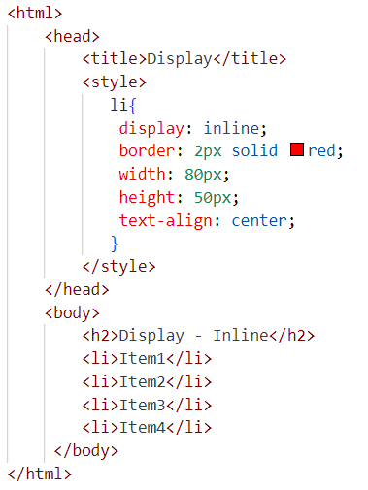
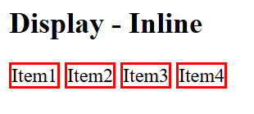
CSS display - inline Value

Slide 4
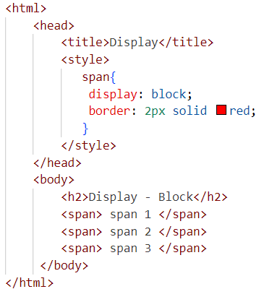
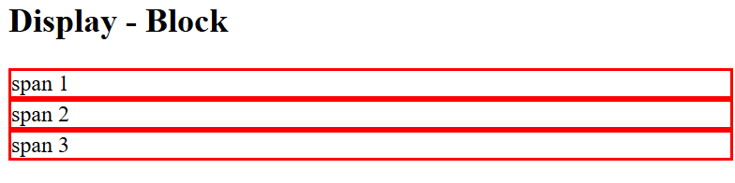
CSS display - block Value

Slide 5
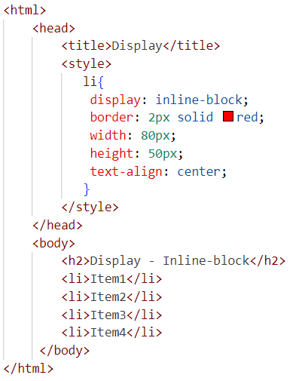
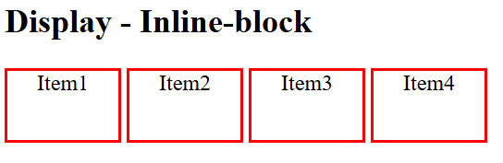
CSS display - inline-block Value

Slide 6
CSS display - Flexbox
The CSS Flexbox is a one-dimensional layout.
Flex layout makes it easier to design and build responsive web pages without using many float and position properties in the CSS code.
To start using Flexbox, you have to create a flex container using the display: flex property.
Every element inside the particular flex container will act as a flex item.
Use cases: Navigating bars, Centering items, responsive single axis layouts.

Slide 7
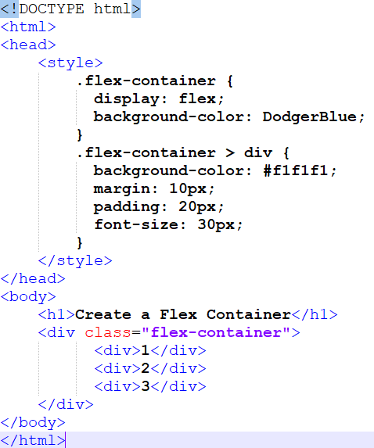
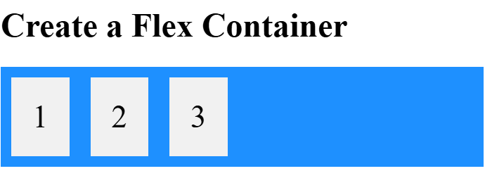

Slide 8
Axes in Flexbox
Main Axis: Direction in which the flex items are laid out.
Cross Axis: Perpendicular to the main axis.
The direction depends on flex-direction.

Slide 9
Key Properties (Parent container: display: flex)
Property | Description
flex-direction | row, column, row-reverse, column-reverse
justify-content | Aligns items horizontally (flex-start, center, space-between, space-around, space-evenly, etc.)
align-items | Aligns items vertically (cross axis) (stretch, center, flex-start, etc.)
align-content | Aligns rows vertically if there are multiple lines
flex-wrap | nowrap, wrap, wrap-reverse (allows items to wrap)

Slide 10

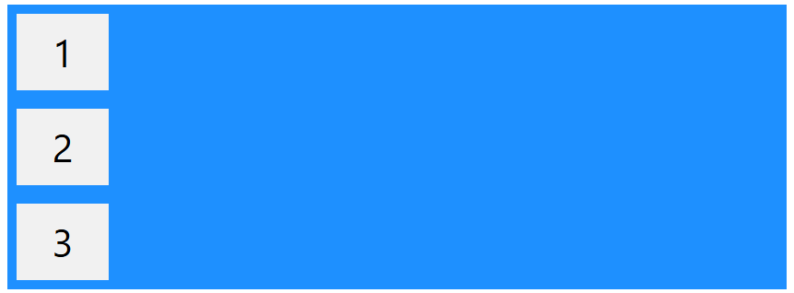

Flex-direction
The row value is the default value, and it displays the flex items horizontally (from left to right):
The column value displays the flex items vertically (from top to bottom):

Slide 11

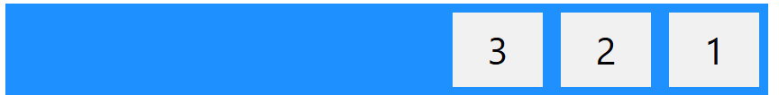

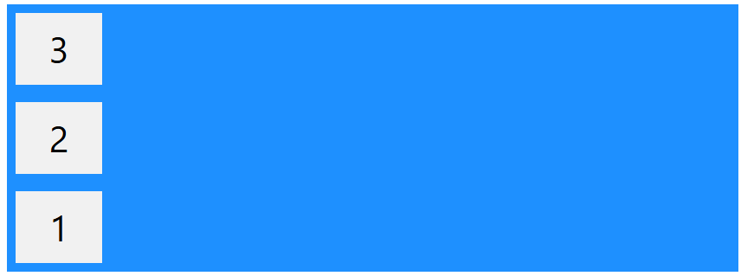
The row-reverse value displays the flex items horizontally (but from right to left):
The column-reverse value displays the flex items vertically (but from bottom to top):

Slide 12

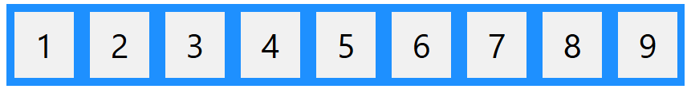

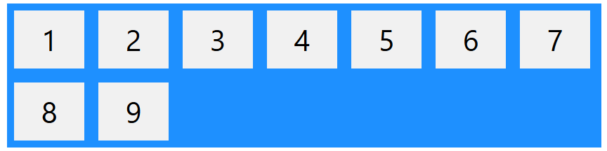
Flex-wrap Property
The flex-wrap property specifies whether the flex items should wrap or not, if there is not enough room for them on one flex line.
The nowrap value specifies that the flex items will not wrap (this is default):
The wrap value specifies that the flex items will wrap if necessary:

Slide 13

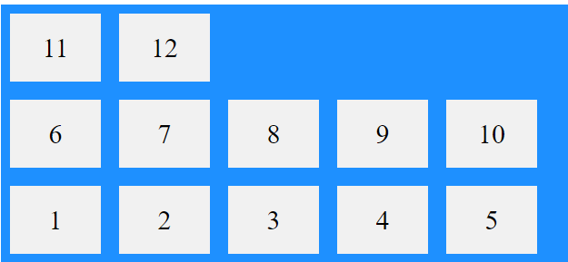
The wrap-reverse value specifies that the flex items will wrap if necessary, in reverse order:

Slide 14

Flex-flow
The flex-flow property is a shorthand property for setting both the flex-direction and flex-wrap properties.

Slide 15


Justify-content
The justify-content property is used to align the flex items when they do not use all available space on the main-axis.
The center value positions the flex items in the center of the container:
The flex-start value positions the flex items at the beginning of the container (this is default).
The flex-end value positions the flex items at the end of the container.
The space-around value displays the flex items with space around them
The space-between value displays the flex items with space between them.
The space-evenly value displays the flex items with equal space around them.

Slide 16





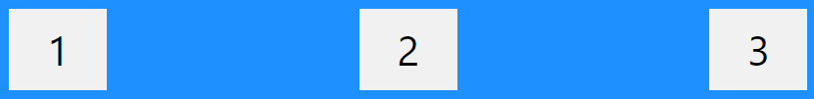



Slide 17
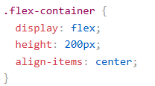
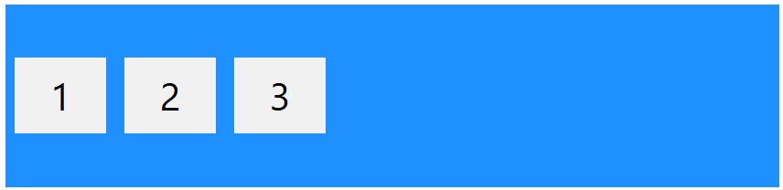
Align-items
The align-items property is used to align the flex items when they do not use all available space on the cross-axis.
The center value positions the flex items in the middle of the container.
The flex-start value positions the flex items at the top of the container.
The flex-end value positions the flex items at the bottom of the container.
The stretch value stretches the flex items to fill the container (this is equal to "normal" which is default)

Slide 18
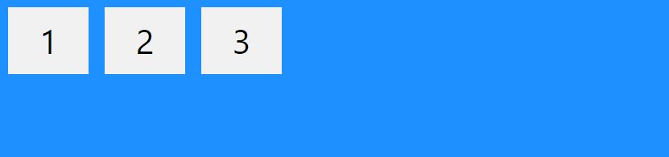
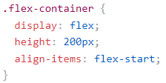
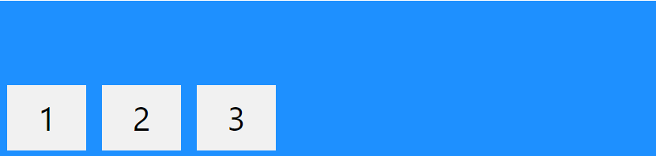
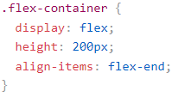
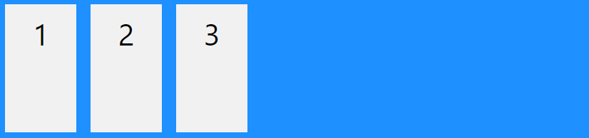
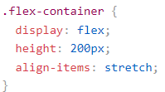

Slide 19
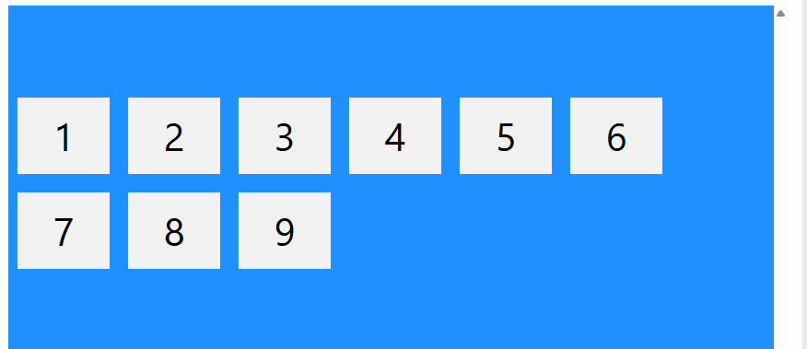
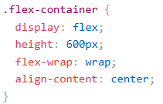
Align-content
The align-content property is used to align the flex lines.
The align-content property is similar to align-items, but instead of aligning flex items, it aligns the flex lines.
With center, the flex lines are packed toward the center of the container:
Other possible values: stretch, flex-start, flex-end, space-around, space-between, space-evenly

Slide 20
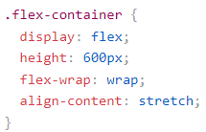
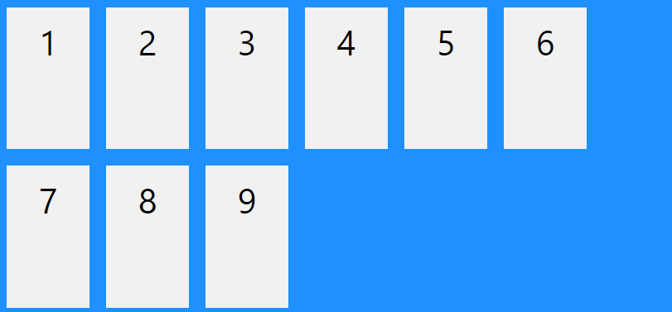
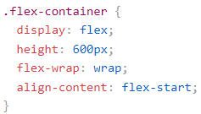
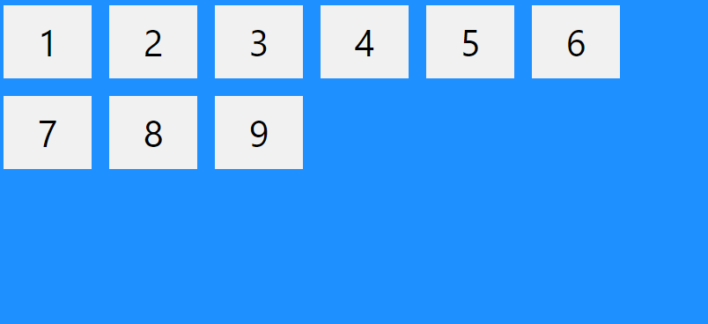
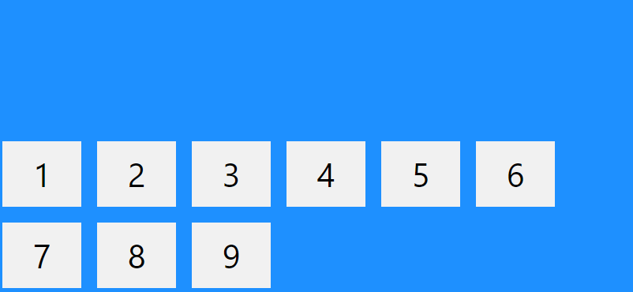
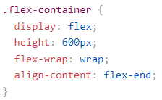

Slide 21
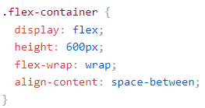
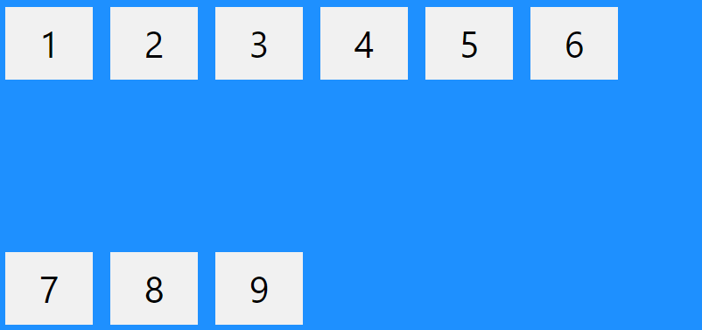
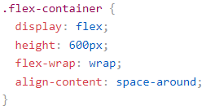
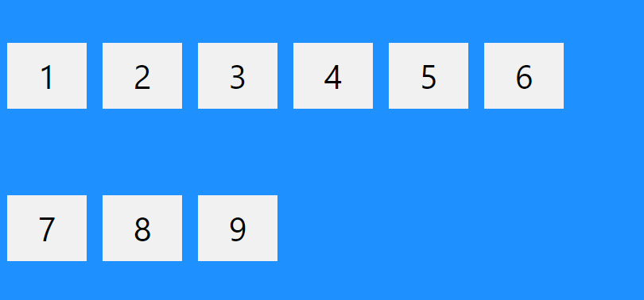
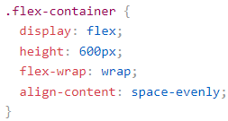
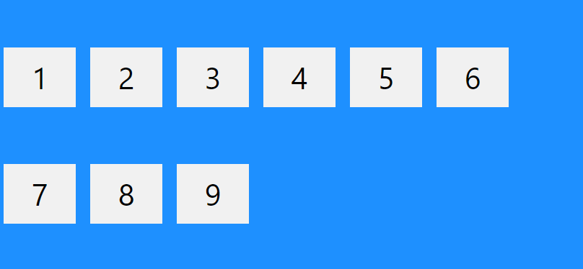

Slide 22
Key Properties (flex items)
Each child of a flex container can be individually styled.
Property | Description
flex-grow | Allows items to grow to fill space
flex-shrink | Shrink if needed
flex-basis | Initial size before growing/shrinking
flex | Shorthand: flex: grow shrink basis
align-self | Overrides align-items for an individual item

Slide 23
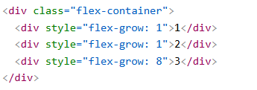
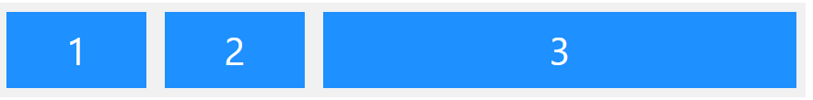
Flex-grow
The flex-grow property specifies how much a flex item will grow relative to the rest of the flex items.
The value must be a number, default value is 0.

Slide 24
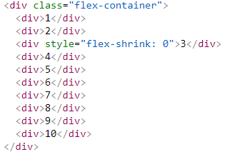

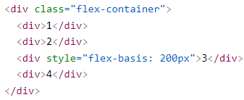

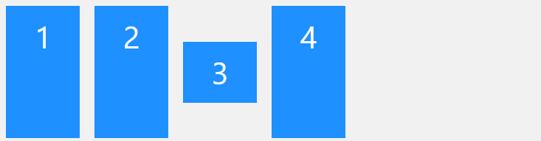
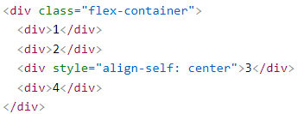
flex-shrink
flex-basis
align-self

Slide 25
CSS display - Grid
The CSS Grid Layout is a two-dimensional grid-based layout system with rows and columns.
It is useful in creating more complex and organized layouts.
Like tables, grid layout allow us to align elements into columns and rows.
A grid always consists of:
a Grid Container - the parent (container) <div> element
Grid Items - the items inside the container <div>
To get started, a container element as a grid with display: grid
Set the column and row sizes with grid-template-columns and grid-template-rows.

Slide 26
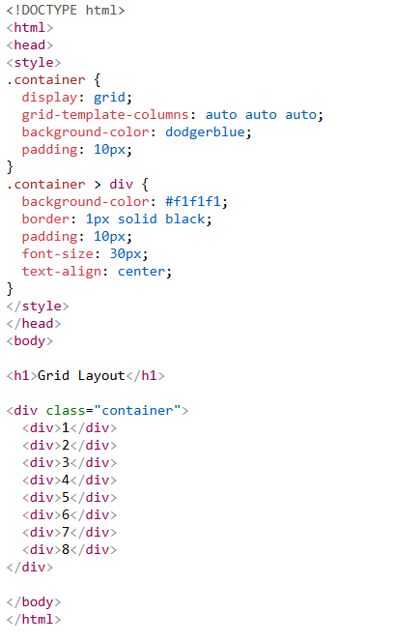
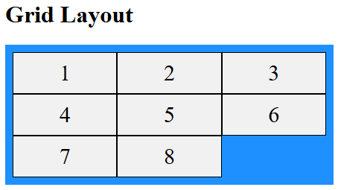

Slide 27
Key Properties (Parent container: display: grid)
Property | Description
grid-template-columns | Defines columns: e.g., repeat(3, 1fr)
grid-template-rows | Defines rows: e.g., 100px auto 1fr
grid-template-areas | Named grid areas
gap or row-gap / column-gap | Space between cells
justify-items | Aligns grid items horizontally within cells
align-items | Aligns grid items vertically within cells

Slide 28
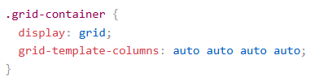
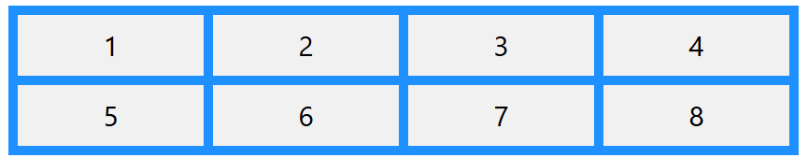

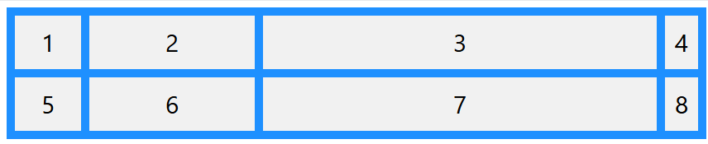
grid-template-columns
The grid-template-columns property defines the number of columns in your grid layout, and it can define the width of each column.
The value is a space-separated-list, where each value defines the width of the respective column.
The grid-template-columns property can also be used to specify the exact size (width) of the columns, or a mix of fixed size and auto.

Slide 29

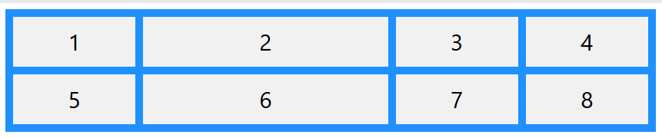
Cell Sizing with the fr Unit
The fr unit stands for "fraction". This unit automatically divides the available space into fractions.
Example: 1fr will take 1 fraction of the available space, while 2fr will take 2 fractions of the available space.

Slide 30

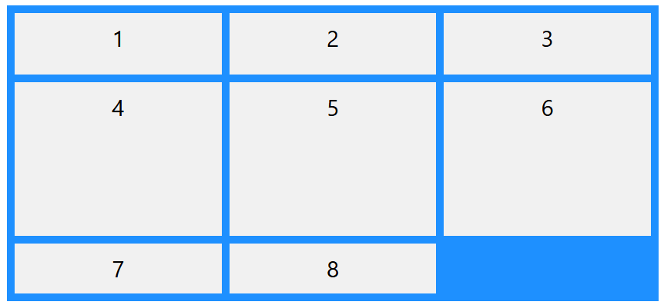
grid-template-rows Property
The grid-template-rows property defines the height of each row.
The value is a space-separated-list, where each value defines the height of the respective row

Slide 31




gap or row-gap / column-gap

Slide 32





Slide 33
Key Properties (grid items)
Property | Description
grid-column / grid-row | Span columns or rows: e.g., grid-column: 1 / 3
grid-area | Position in named grid areas
justify-self | Horizontal alignment of a grid item
align-self | Vertical alignment of a grid item

Slide 34


grid-column-start and grid-column-end
The grid-column-start property specifies where to start a grid item.
The grid-column-end property specifies where to end a grid item.

Slide 35


grid-row-start and grid-row-end Property
The grid-row-start property specifies where to start a grid item.
The grid-row-end property specifies where to end a grid item.

Slide 36
.item1 {
grid-column: 1 / 3; /* spans columns 1 to 2 */
grid-row: 1 / 2;
}
.item2 {
grid-column: 3 / 4;
grid-row: 1 / 3; /* spans rows 1 to 2 */
}

Slide 37


grid-area Property
The grid-area property is a shorthand property for the grid-row-start, grid-column-start, grid-row-end and the grid-column-end properties.
The syntax is grid-row-start / grid-column-start / grid-row-end / grid-column-end.

